Slide 1

CAREER DESIGN
DAN GRANT
2025
PROJECT
No fluff mini guide

Slide 2


TABLE OF
CONTENTS
01
Your Inevitable Future
02
Your Game Plan
Direction beats perfection.
What gets scheduled gets done.
03
Start / Stop / Keep
04
Blind Spots
05
Do The Thing
Clarity isn’t accidentally found. It’s hunted down.
Don’t just work hard. Work smart.
Talking about it isn’t doing it.

Slide 3



WHY THIS MATTERS
“If you don’t know where you’re going, you’ll end up some place else”.
- Yogi Berra
This guide helps you clarify direction, sharpen your strategy, and take action - with tools you’ll actually use.

Slide 4





YOUR INEVITABLE FUTURE
01
Direction beats perfection
Most people drift. High performers design.
Your “Innevitable Future” is where you’re heading if you stay on your current trajectory - or decide to set a better one.
...corporate executive
...entrepreneurial builder
...altruistic philanthropist

Slide 5

EXERCISE 1
Write your rough draft
1
What
2
Where
What are you doing?
Where are you doing it?
3
4
Who
Why
Who are you working with?
Why is this important?

Slide 6



02
YOUR GAME PLAN
What gets scheduled gets done
Break your ambition into time-bound focus points using the 10 / 3 / 1 framework
TODAY
1 Year
3 Years
10 Years
YOU ARE HERE
SMART goals
Strategic focus
Vision
“Most people overestimate what they can do in one year and underestimate what they can do in ten years”.
- Bill Gates’ Law

Slide 7
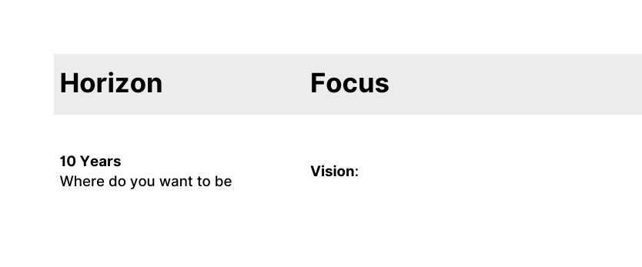
EXERCISE 2
Break down your plan
Bonus: divide your 1 year goal into quarterly objectives
Q1
What happens next...
Q2
...and now...
Q3
...and then...
BE BOLD. BE BRAVE.
Q4
...and finally.

Slide 8


START / STOP / KEEP
03
Clarity isn’t accidentally found.
It’s hunted down.
This simple framework helps you cut through the noise and focus on what’s important.
Start
Stop
Keep
What you should be doing
What’s no longer serving you
What works and needs protection

Slide 9
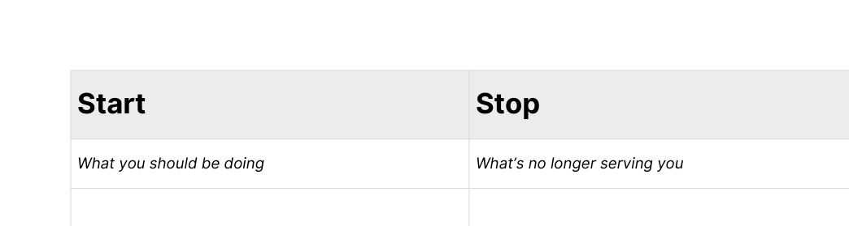
EXERCISE 3
Complete the table
Ask your manager for feedback
Ask a mentor for perspective
Your answer
Manager
Mentor

Slide 10

04
BLIND SPOTS
Don’t just work hard. Work smart.
Most people reflect once a year - usually when it’s too late.
Build your own feedback loop and ask the hard questions.
We all have blind spots. Don’t crash into yours.
“Life moves pretty fast. If you don’t stop and look around once in a while - you could miss it.”
- Ferris Bueller

Slide 11
EXERCISE 4
Book 2 hours this week.
Do the review.
Write it down.
1
2
Where am I underperforming?
Where am I not growing?
3
4
What am I pretending to know?
How do the best do it differently?

Slide 12

05
DO THE THING
Talking about doing the thing isn’t doing the thing.
Writing the thing on a ‘to do’ list isn’t doing the thing.
Listening to me tell you to do the thing isn’t doing the thing.

Slide 13


NEXT STEPS
Do it.
“Life rewards action, not intelligence.
Many brilliant people talk themselves out of getting started, and being smart doesn't help very much without the courage to act.
You can't win if you're not in the game."
- James Clear
Now you’ve got the tools.
It’s time to do the work.
Share it.
Send it to your mentor.
Send it to me.

Slide 14

THANK YOU
Sign up to The Deal Space

